Slide 1


Progress Report: 6
Team Charlie
Aakansha Bhatt, Anshu Paudyal, Ingmar Diaz, Michael Foster, Raunaq Chopra, Yang Ye
10th Feb 2021

Slide 2
Teamwork via zoom
We explain the work done together as a team:
N/A

Slide 3
Aakansha Bhatt
Last week 5 | This week 6
Hardware: N/A | Hardware: N/A
Mechanical: I will be working with Ingmar on the 3D enclosure for the PCB layouts on Fusion 360. | Mechanical: We will be finishing the 3D enclosure this week.
Firmware: Speedometer code displaying data during acceleration and deceleration. Code is working but TA said use another sensor. | Firmware: N/A
Software: same as above | Software: N/A

Slide 4
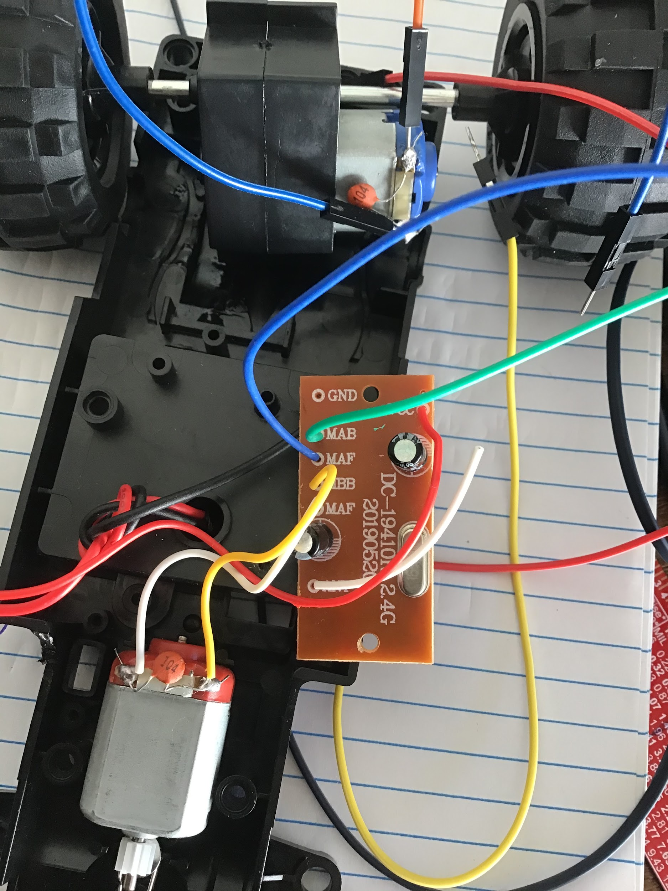
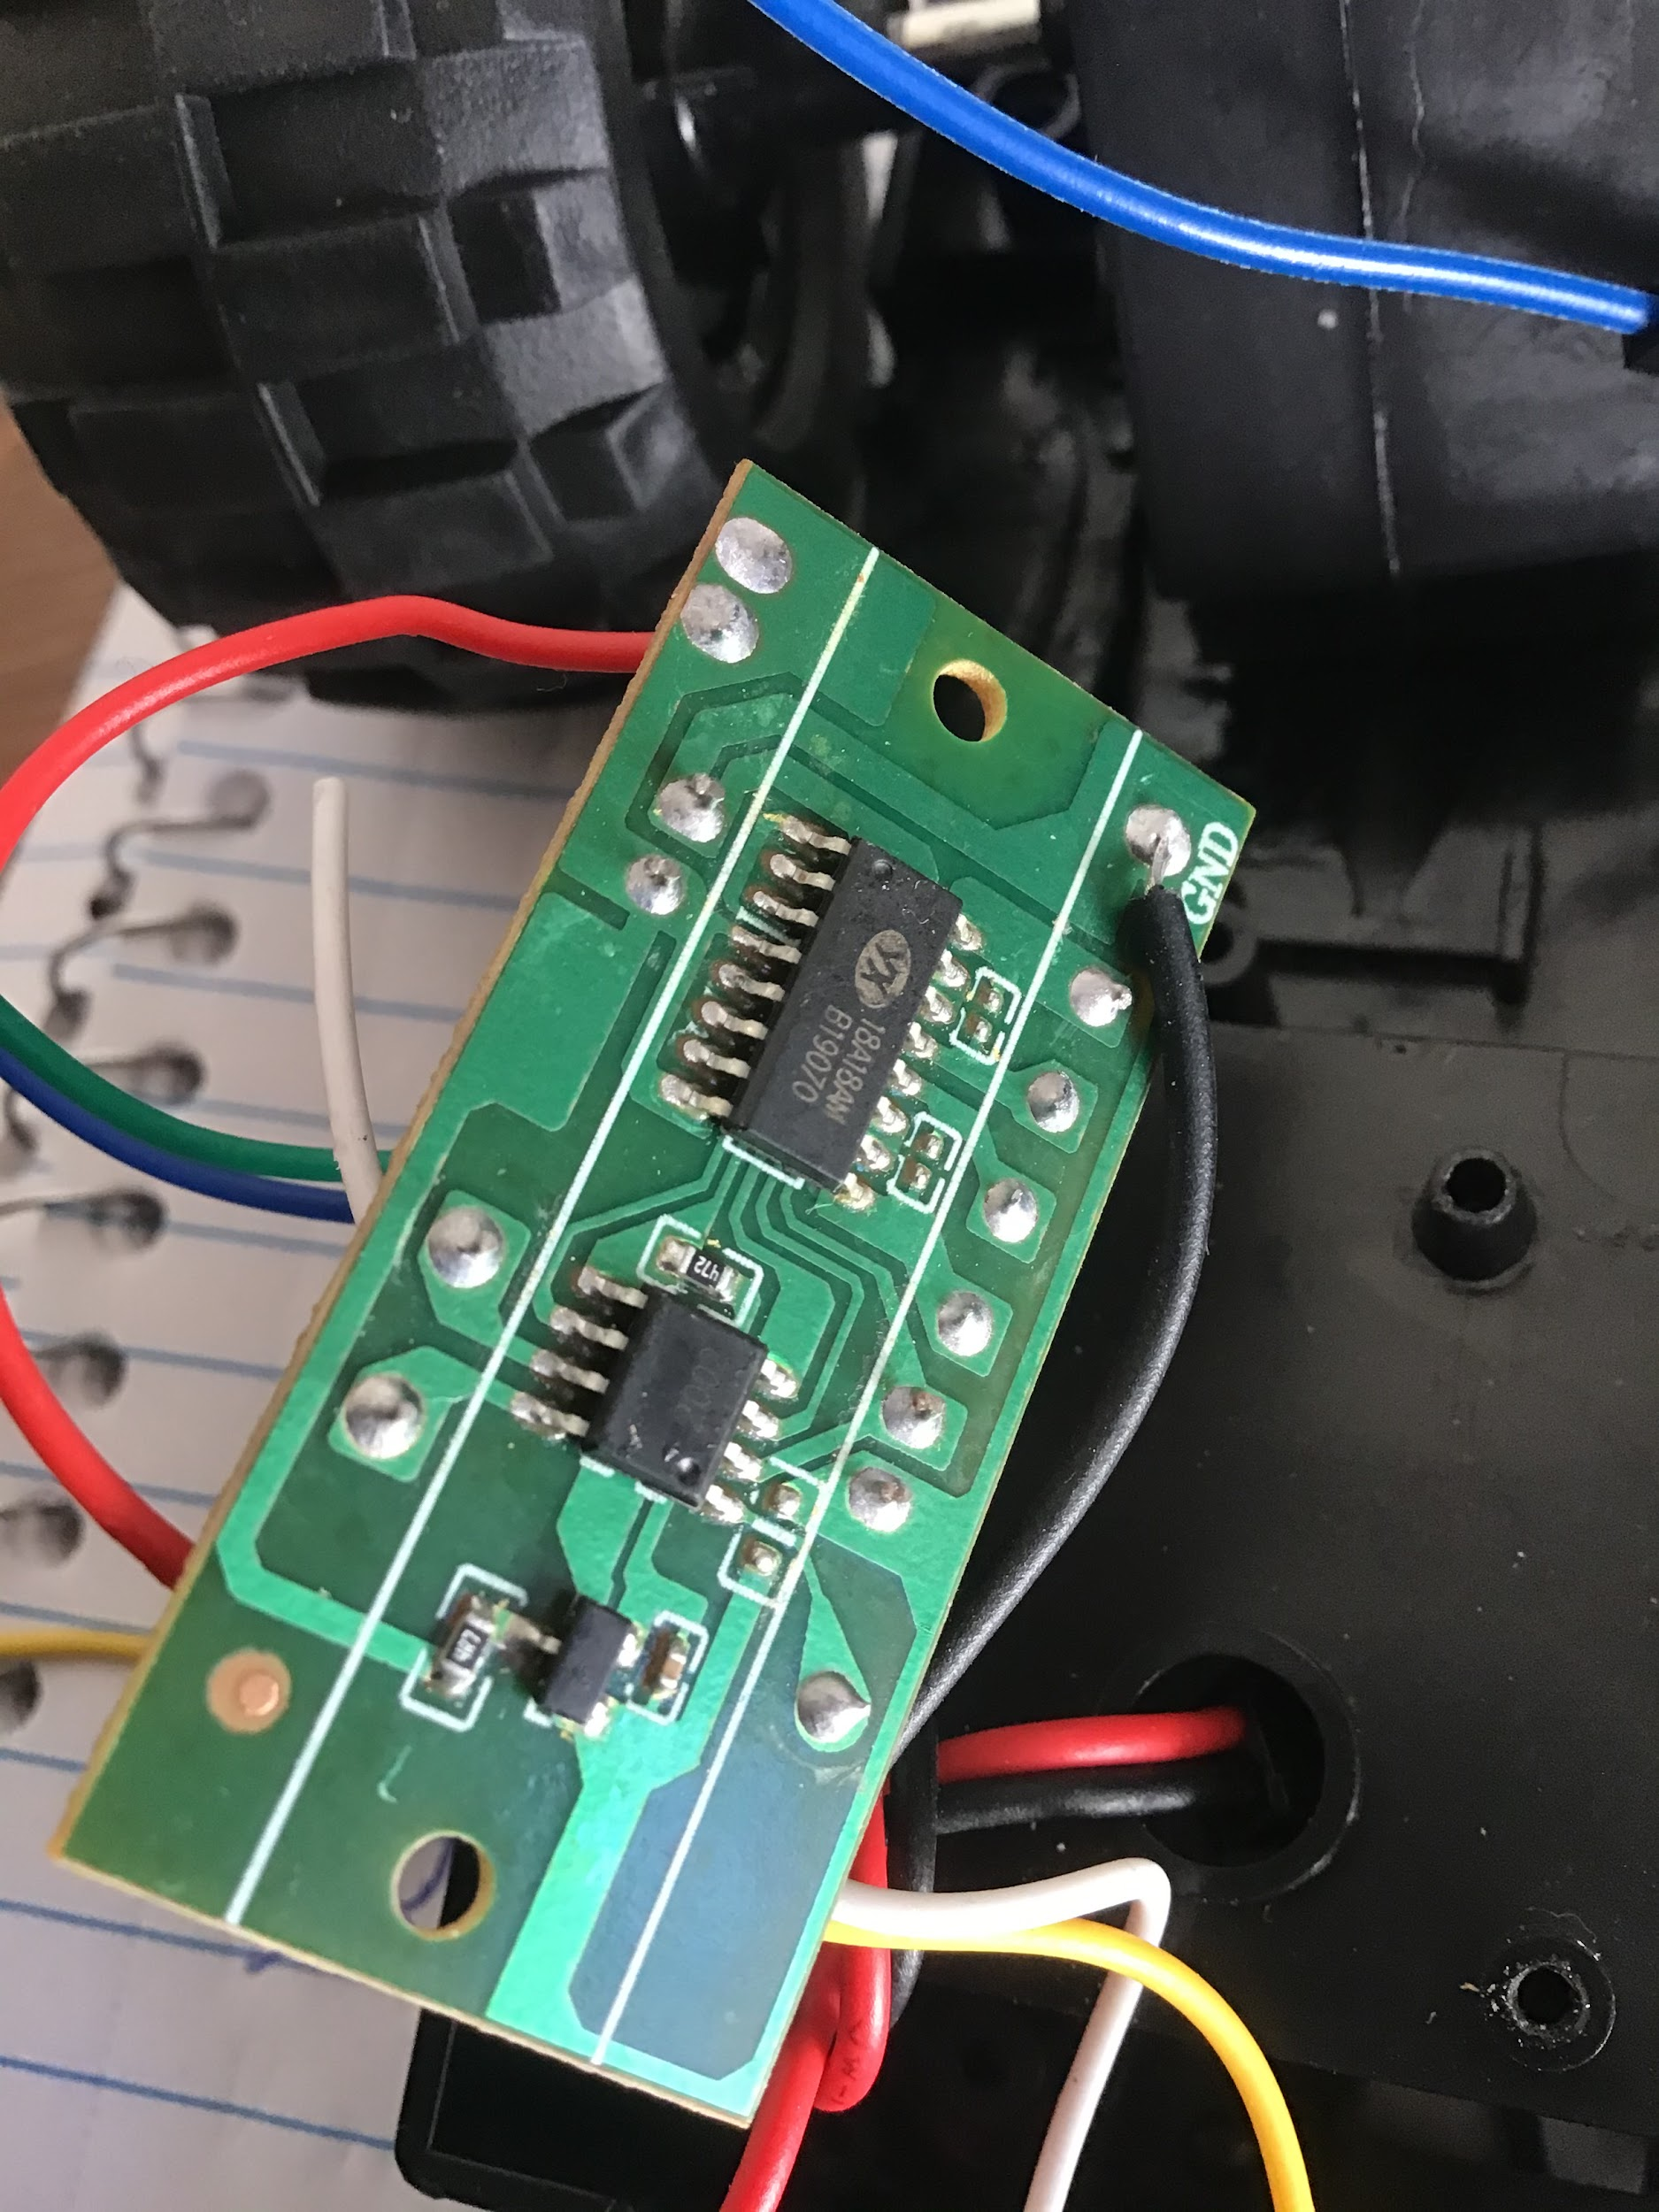
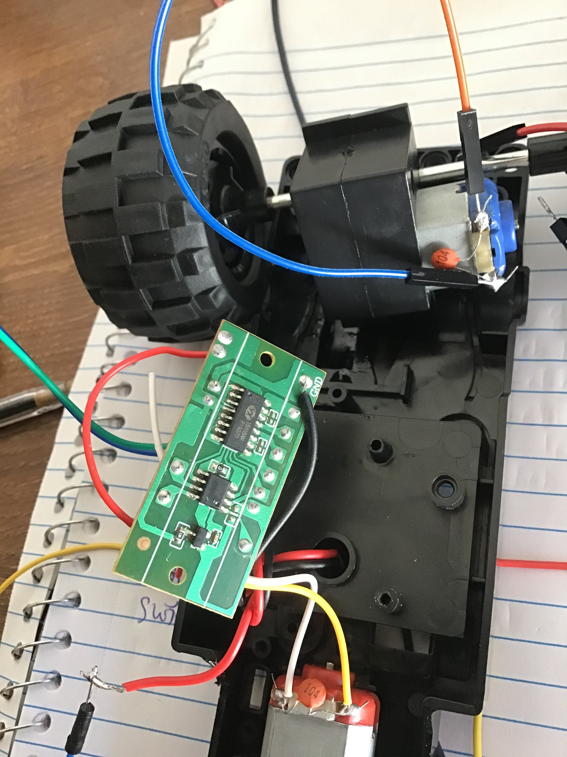
Anshu Paudyal

Slide 5
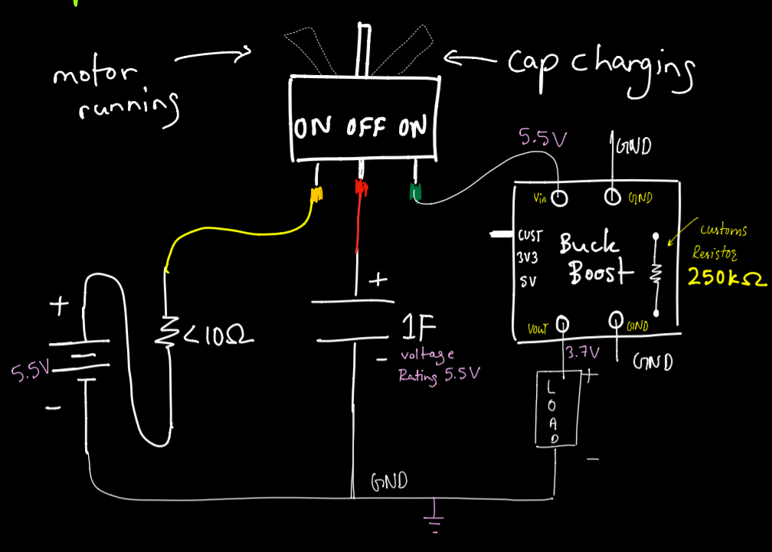

Anshu Paudyal

Slide 6

Anshu Paudyal
Rechargeable battery
3.7V
capacity of 400mAh
energy stored is 1.48kJ
Capacitor
1F
voltage rating: 5.5V
charge stored = 5.5C
stored energy = 0.015125 kJ
capacity of only 2.7mAh
Conclusion: No issue with H-bridge
If we get two 350F caps with Voltage rating 2.7 each, put them in series which gives voltage of 5.4 and capacitance of 175F. The energy stored will be 2.55 kJ and the capacity will be 472.49 mAh. Which is pretty close to the battery that came with the rover.
Reference:
https://www.omnicalculator.com/physics/capacitor-energy https://jumk.de/math-physics-formulary/capacity.php

Slide 7
Ingmar Diaz
Last week 4 | This week 5
Hardware: Finished most of altium design Waiting to implement some components and verifying connections with team | Hardware: Finish Altium Alpha prototype Design Breakout Board by this weekend latest early week 6
Mechanical: | Mechanical:
Firmware: Ordered new OLED displays need to sync with Michael and Aakansha most likely end of week 5l | Firmware: Researched New OLED’s Began coding firmware from OLED, Meeting with Aakansha and Michael Today 2/4. Also heading to OH today 2/4 Oled is displaying, now to develop and test code to display accelerometer data.
Software: Code in PSOC so that we are able to display most likely end of week 5 | Software: Debugging and testing OLED display code

Slide 8
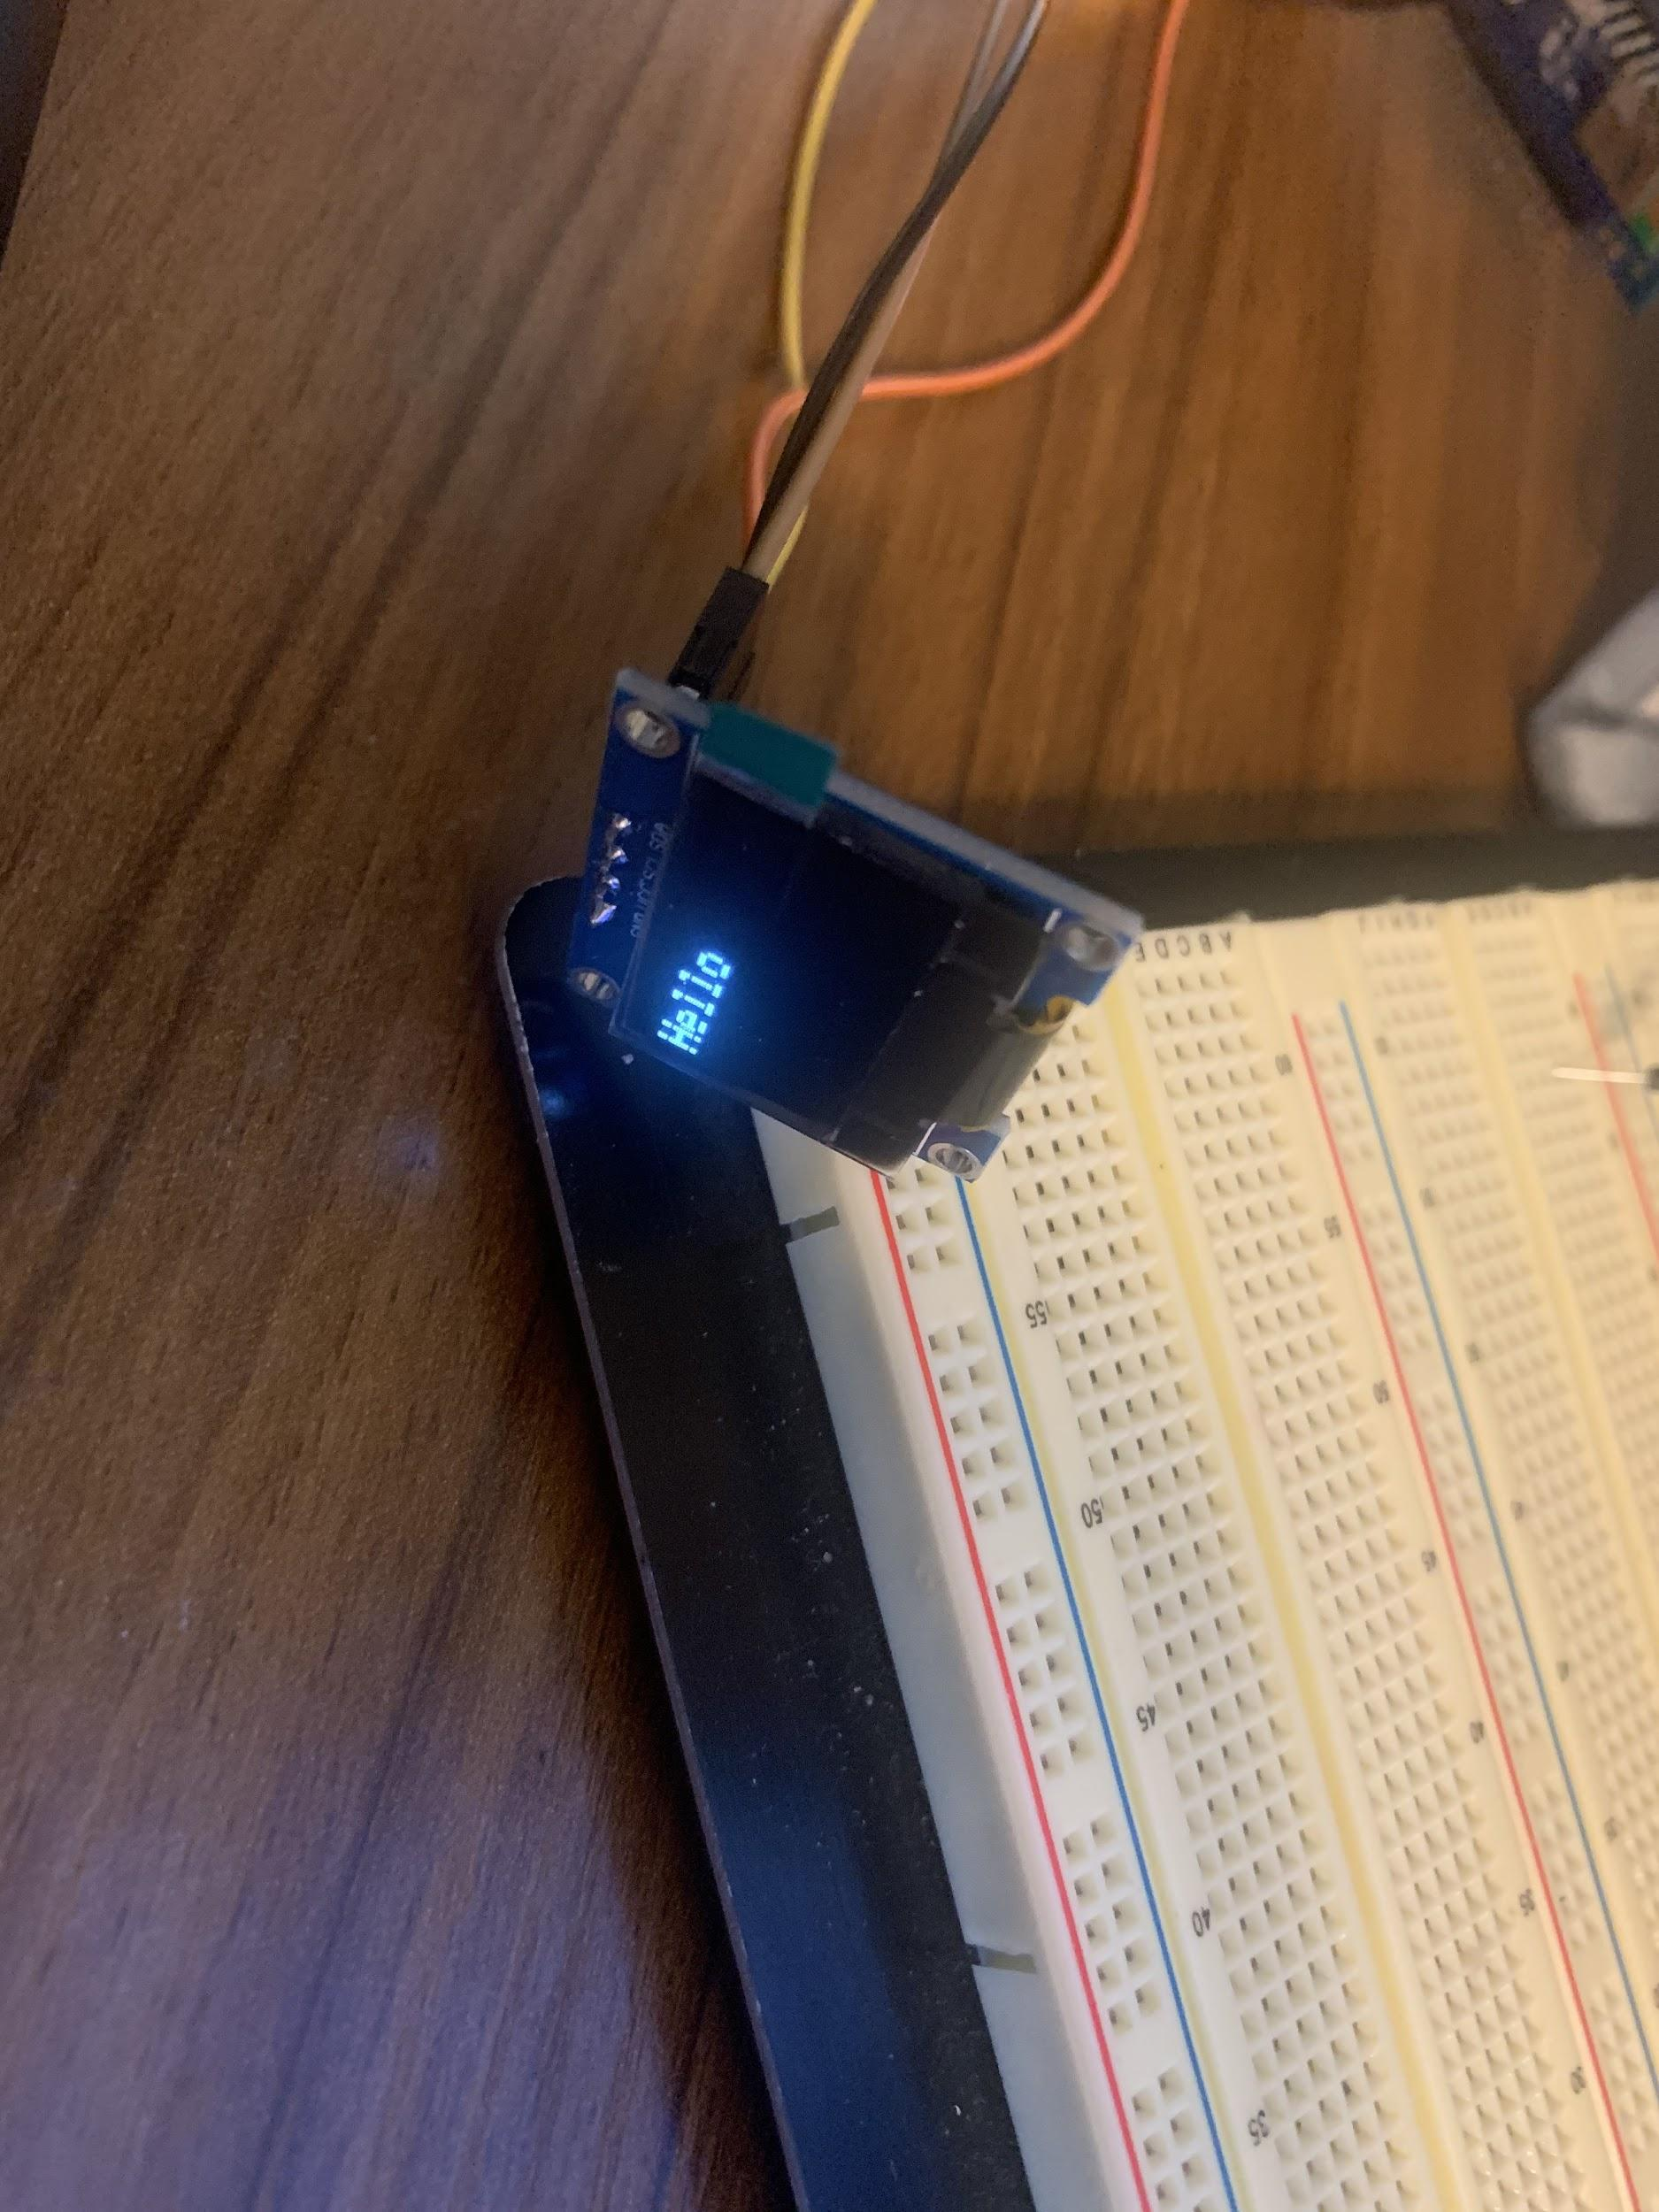

Ingmar Diaz
OLED Display

Slide 9
Michael Foster
Week 5 | This Week: 6
Hardware: N/a | Hardware: N/a
Mechanical:N/a | Mechanical:N/a
Firmware: Meeting with Aakansha and Ingmar on 2/4. | Firmware/Software: Spending my spare time researching and trying to figure out how to make a solar fuel gauge using the
Software: Debugging and testing OLED display code. Got OLED ready and working. | Psoc, and Psoc Software. Other classes and recent deadlines/quizzes have kept me really busy. Also researching functions for OLED.

Slide 10
Raunaq Chopra
Week 5:
Hardware: The altium design is complete as of this week (screenshot of our design is included on the next slide; the only steps remaining on the PCB design is to include component labels. Since this was completed shortly before the meeting, labels could not be added but will be present in the alpha prototype submission
Week 5:
Firmware and Software: Our main focus is on developing the code for a working speedometer using the LIS3DH accelerometer, to have it ready when the alpha prototype is due.

Slide 11
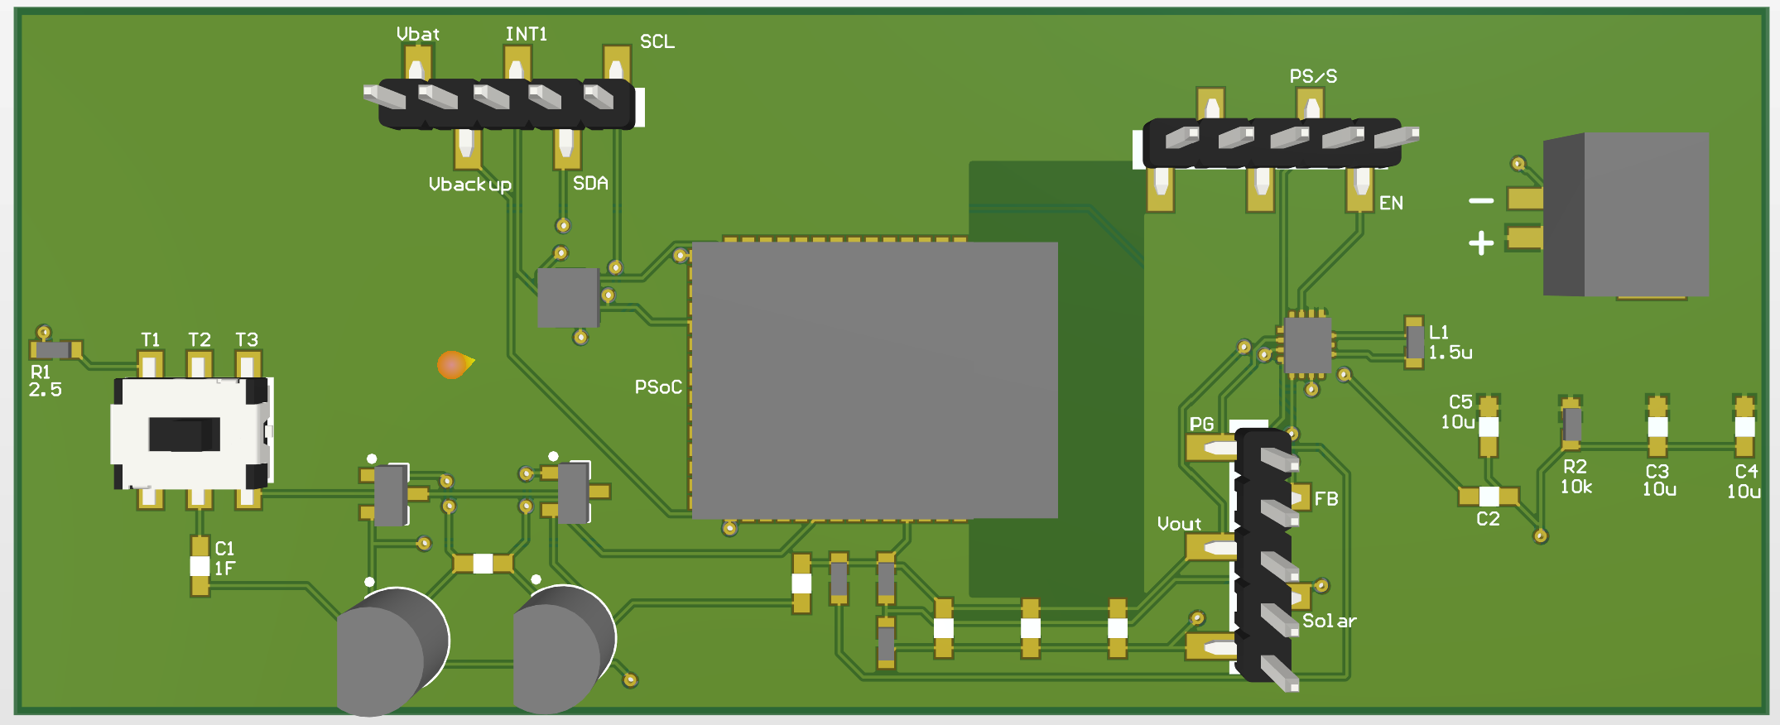
Raunaq Chopra

Slide 12
Yang Ye
Hardware: The video captured by the camera on the rover can be transmitted remotely to a receiver. The data stream will be then processed by the PC terminal. using OpenCV libraries)
Firmware: Setting up RGB screen to display the real time video captured remotely by the camera
Software: Installing OpenCV library.
Writing up report and record alpha demo video.

Slide 13
Bill of Materials and Project Budget:
Rover Truck + Solar Panels +
SPDT switches + 10x*0.1F capacitors +
Box of capacitors +
shipping for Switches and cap = $87.42 + $13.00 + $8.28 + $18.39 + $13.39 ~ $140.48
Project Schedule and Risk Assessment: MILESTONES - Google Docs
Report and Presentation: 12th Feb 2021
Marketing and Video: 11th Feb 2021
Tips:
1. Be sure to identify tasks and contributions of each team member.
2. Use pictures as much as possible for effective communication.

